Slide 1
Group Name: Purrfectly meow

Slide 2
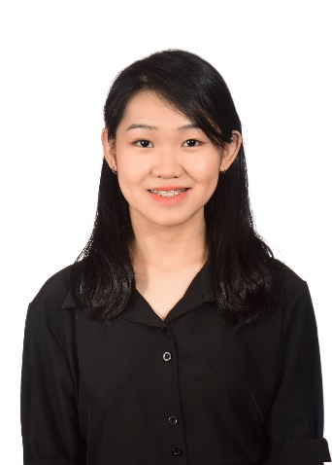
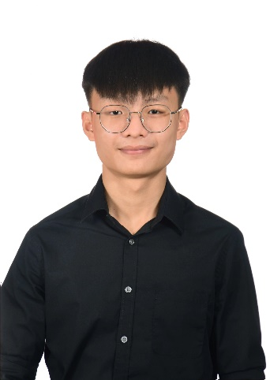
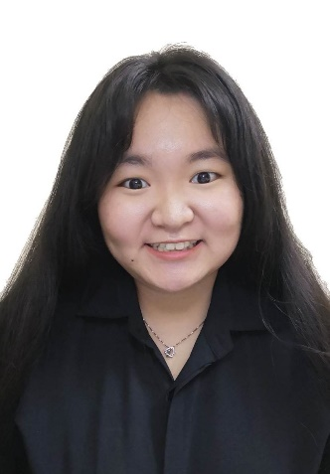
Group Members
Student Name | Foo Kar Yeng | Liew Ren Yi | Tan Yi Fei | Wong Pei Kei
Student ID | 23ACB00422 | 23ACB00434 | 22ACB00842 | 22ACB07466
Practical Group | P4 | P4 | P1 | P2
Web pages created | mainpage.html appointment.html FAQs.html | service.html daycare.html boarding.html grooming.html training.html | login.html donation.html | aboutus.html givingback.html

Slide 3
(Member 1 - <LIEW REN YI>)
Present & demo web pages that had been develop and include what technologies that had been applied.

Slide 4
(Member 2 - <FOO KAR YENG>)
Present & demo web pages that had been develop and include what technologies that had been applied.

Slide 5
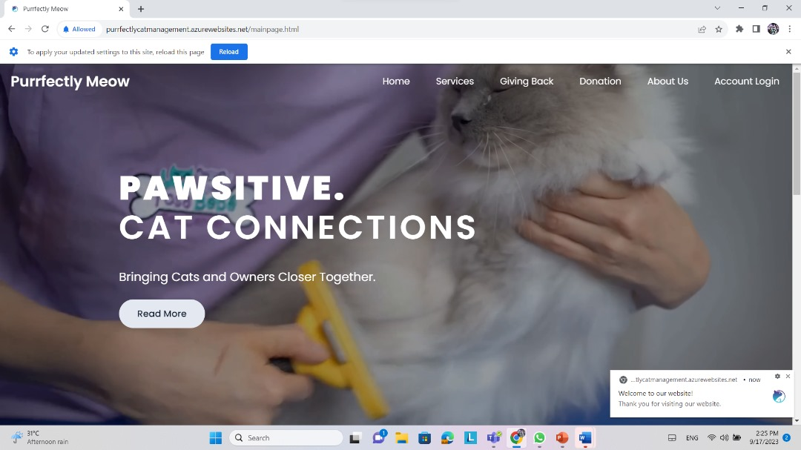

Slide 6
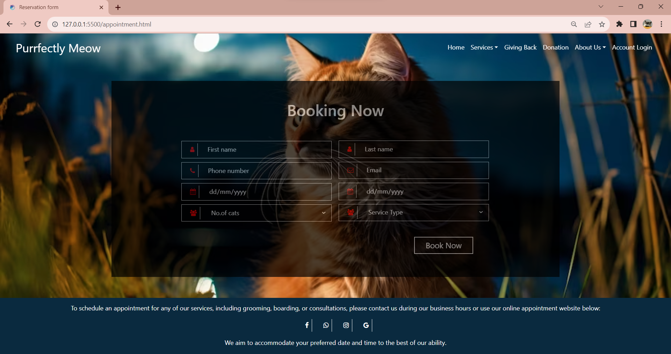

Slide 7
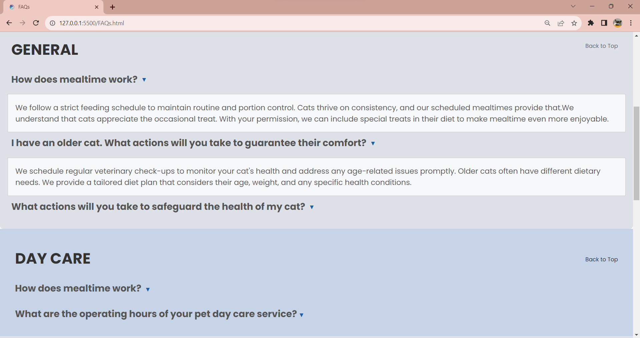

Slide 8
(Member 3 - <WONG PEI KEI>)
Present & demo web pages that had been develop and include what technologies that had been applied.

Slide 9
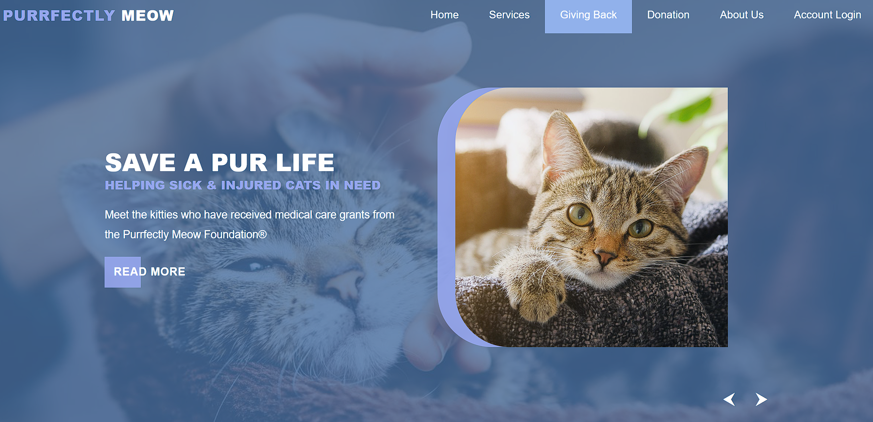

Slide 10
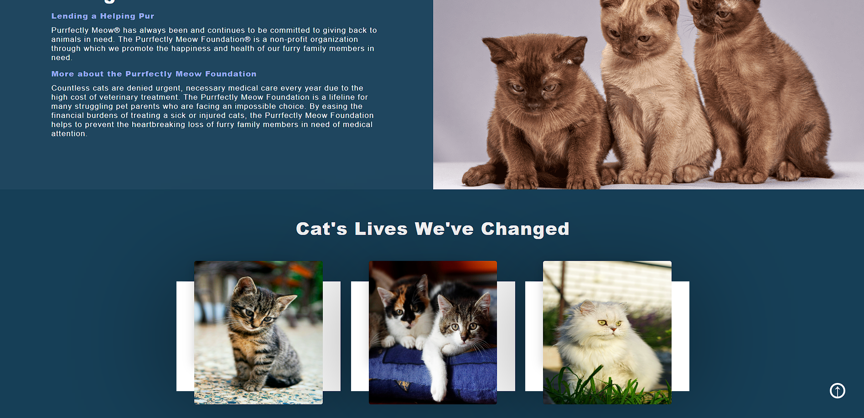

Slide 11
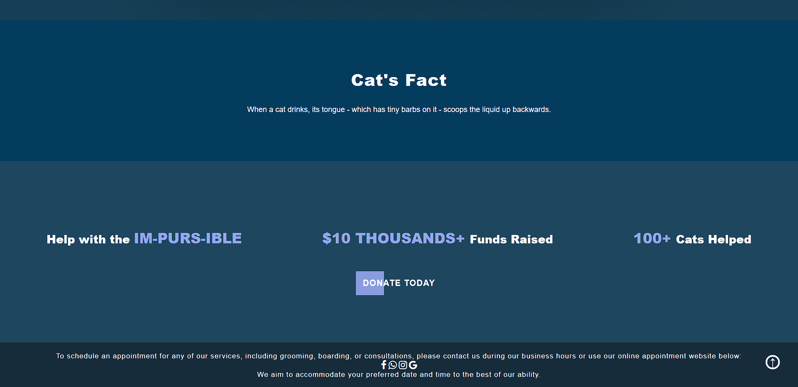

Slide 12
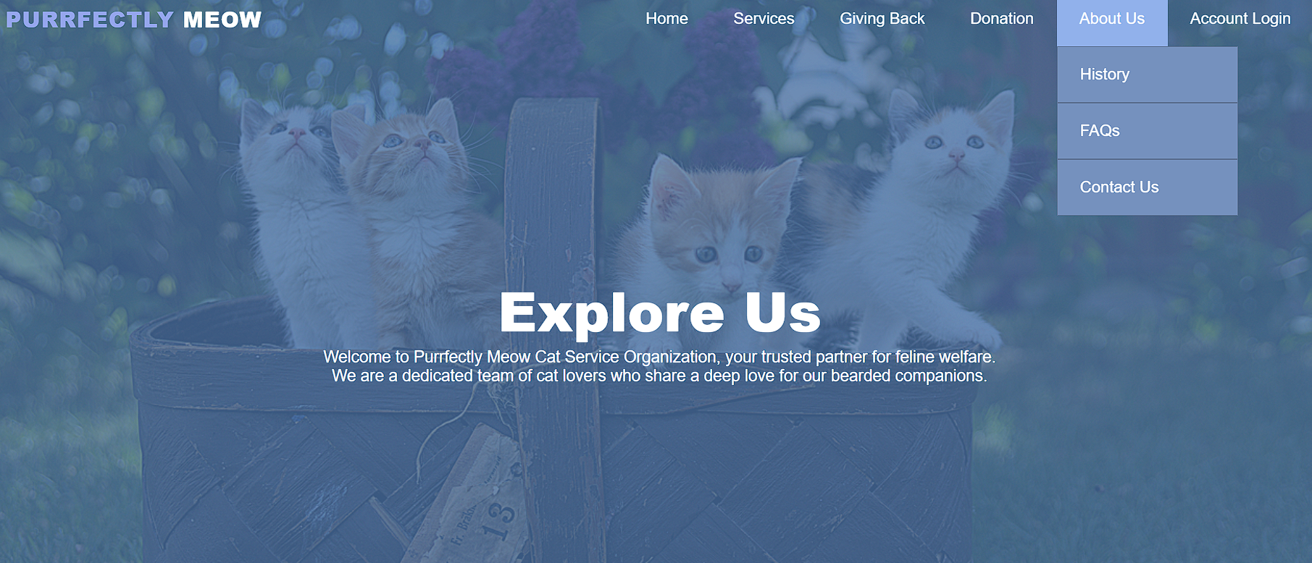

Slide 13
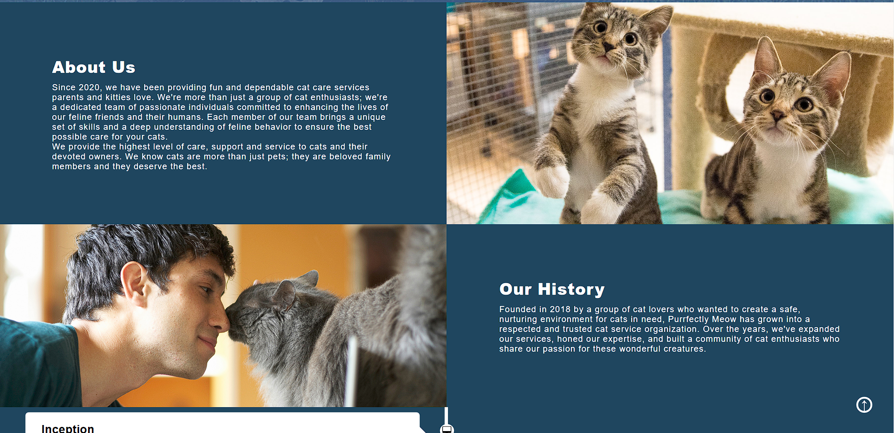

Slide 14
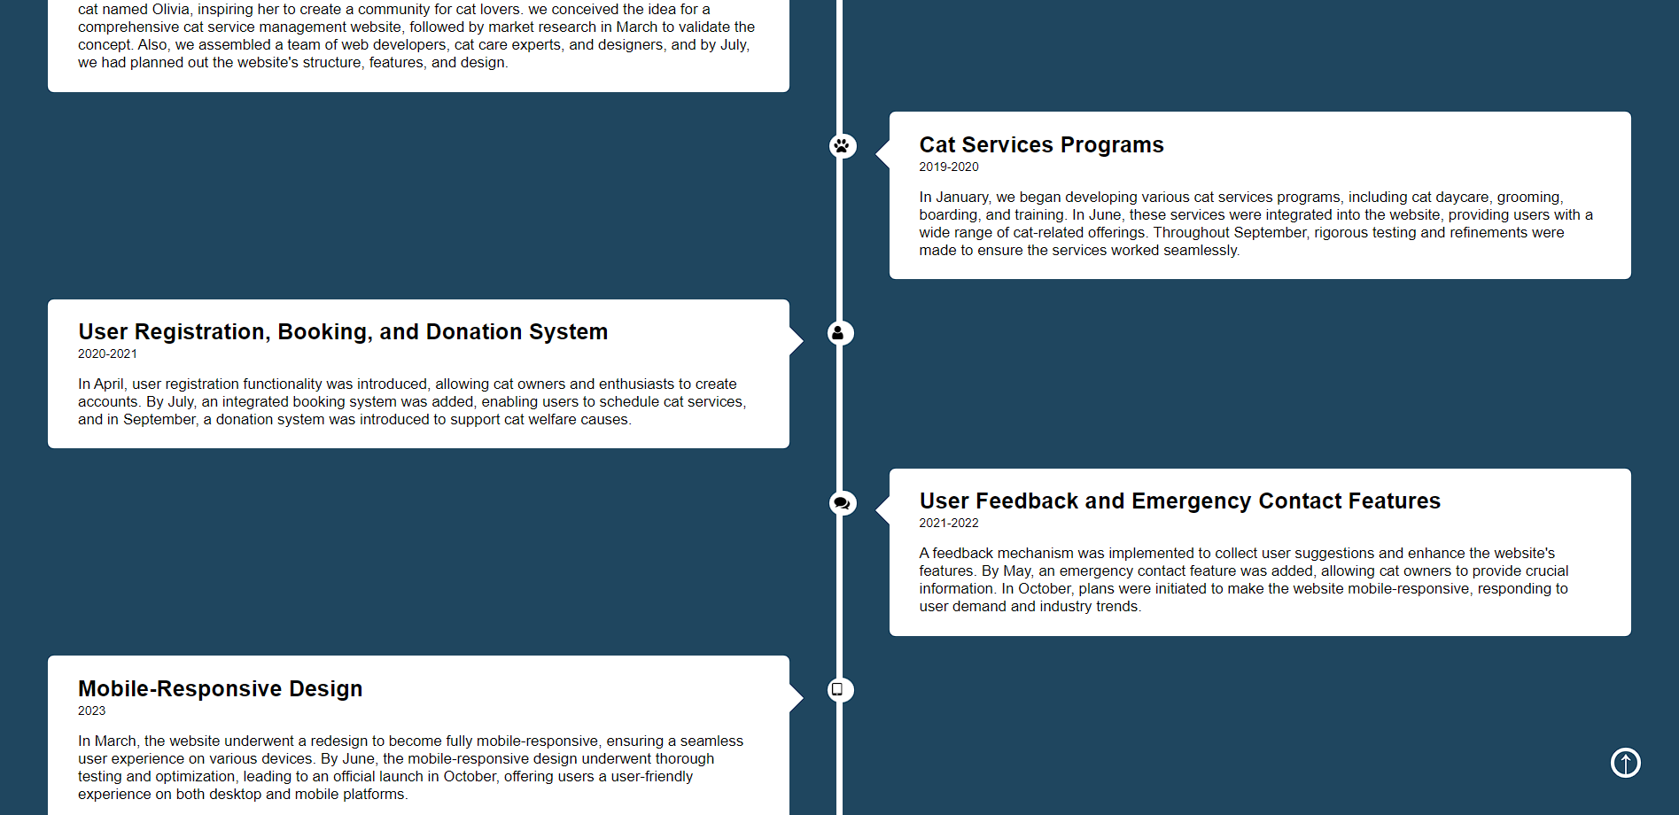

Slide 15
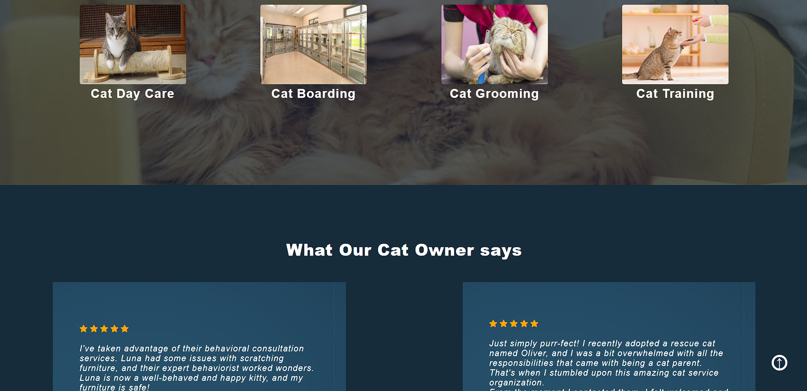

Slide 16
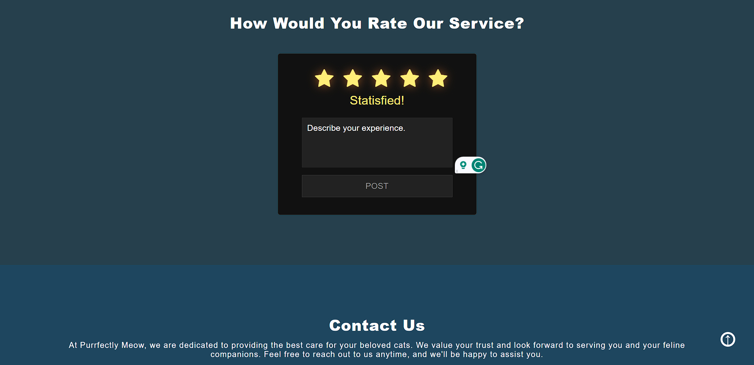

Slide 17
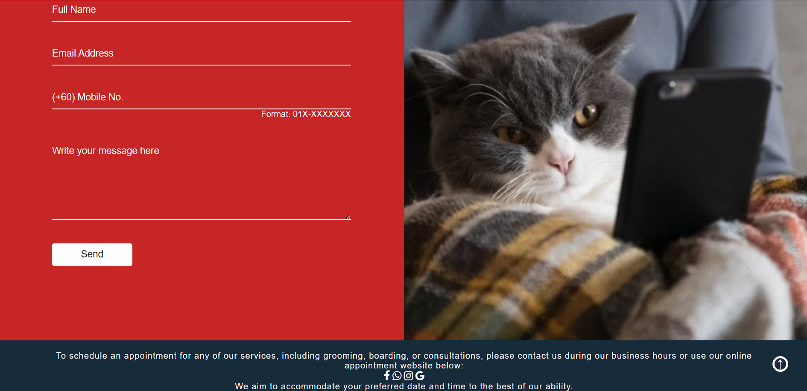

Slide 18
(Member 4 - <TAN YI FEI>)
Present & demo web pages that had been develop and include what technologies that had been applied.

Slide 19
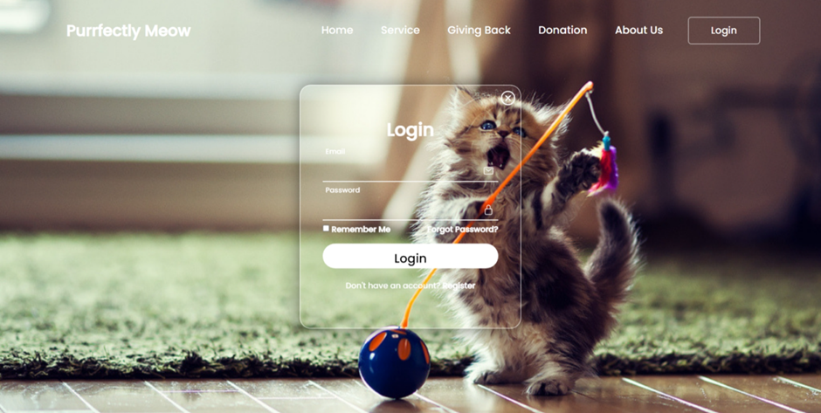

Slide 20
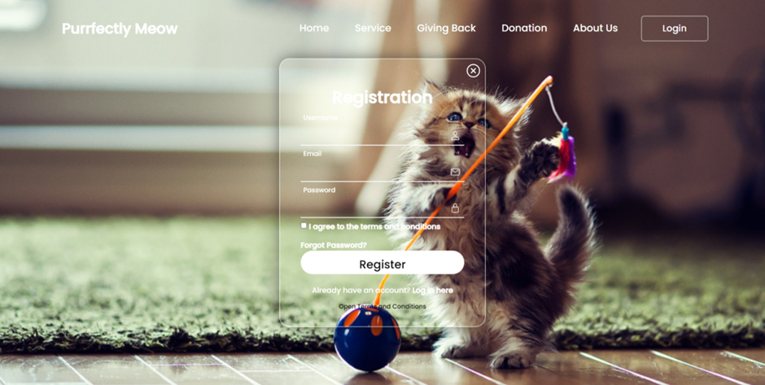

Slide 21
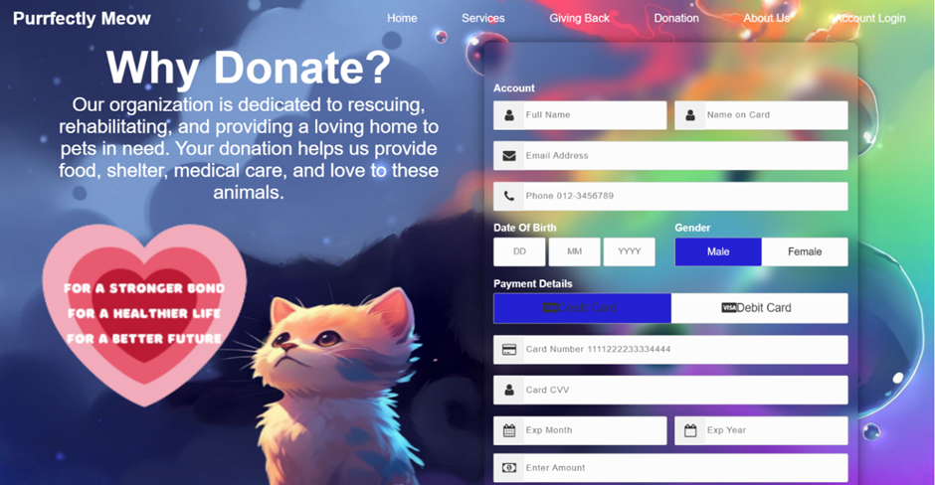
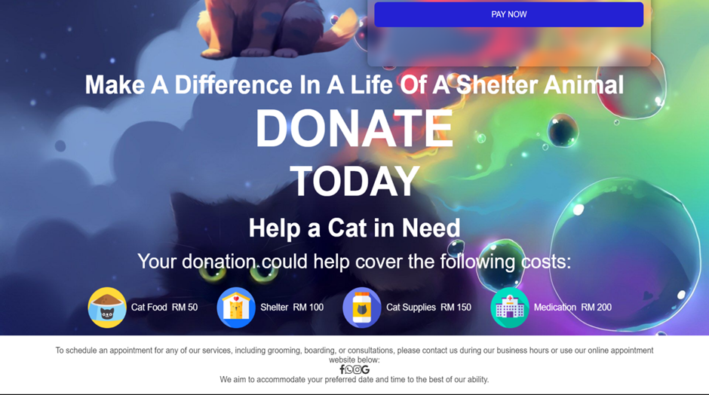

Slide 22


